Slide 1
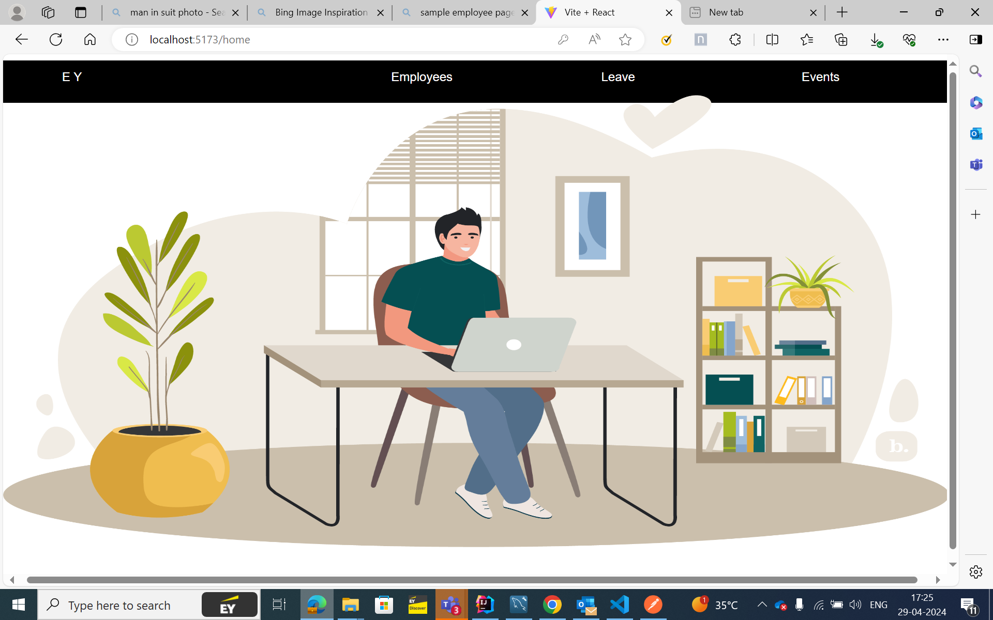
E-CALENDER
Team members :
Prem Pratyush Mohanty
Pushpendu Arunkumar Samanta
Kadiyala Bharadwaj
Lucent Dev Dunne
Gundam Gouthamsai
Ayush Singh

Slide 2
Product backlog
US ID | Name | story | Expected | Team Member ID | Priority | Status
US 01 | Kadiyala Bharadwaj | Login page and routing for all components and fine-tuning all css components | A login page should be built and all components should be routed. | 1 | High | COMPLETED
US 02 | Prem Pratyush Mohanty | building dashboard/homepage , fetching employee details | A homepage/dashboard should be built that would have 3 buttons that would redirect to the specific components | 2 | High | COMPLETED
US 03 | Gundam Gouthamsai | Employee details page and events page and fine-tuning of all css components | Employee page should contain thumnails of employee details upon clicking which should display employee details. | 3 | High | COMPLETED
US 04 | Ayush Singh | Authentication for login | Authentication should be succesful upon login after which it should redirect to homepage | 4 | High | COMPLETED
US 05 | Pushpendu Arunkumar Samanta | Backend for employee database | A database for the employees should be built and should be connected to the springboot | 5 | High | COMPLETED
US 06 | Lecent Dev Dunne | Leaves page for employee and events page | Leave page should display the number of leaves availed and leaves left and events page should display a calender where events can be scheduled. | 6 | High | COMPLETED

Slide 3
Problem Statement
We need a React-based web application for efficient employee management. The application should include features like a registration form for new employees, a secure login for managers, and a comprehensive view of employee information and schedules. It should also display upcoming organizational events and provide graphical insights for informed decision-making. The challenge lies in creating a user-friendly, secure, and scalable solution that enhances operational efficiency.

Slide 4
DESCRIPTION
The system features a secure login page, accessible only to managers. Upon logging in, managers can access and manage data for each team member. This stored information includes general details (such as name and contact information), designation, leaves availed, date of joining (DOJ), upcoming events, projects assigned, and a unique user ID for each employee. The system is implemented in Java, leveraging its robust features for efficient data handling and security. Here, managers can promptly approve or reject leave requests. An effective portal contributes to better employee engagement, productivity, and overall employer branding.
Technologies used : - Spring Boot, Spring JPA, Hibernate for Validations, React, MySQL

Slide 5
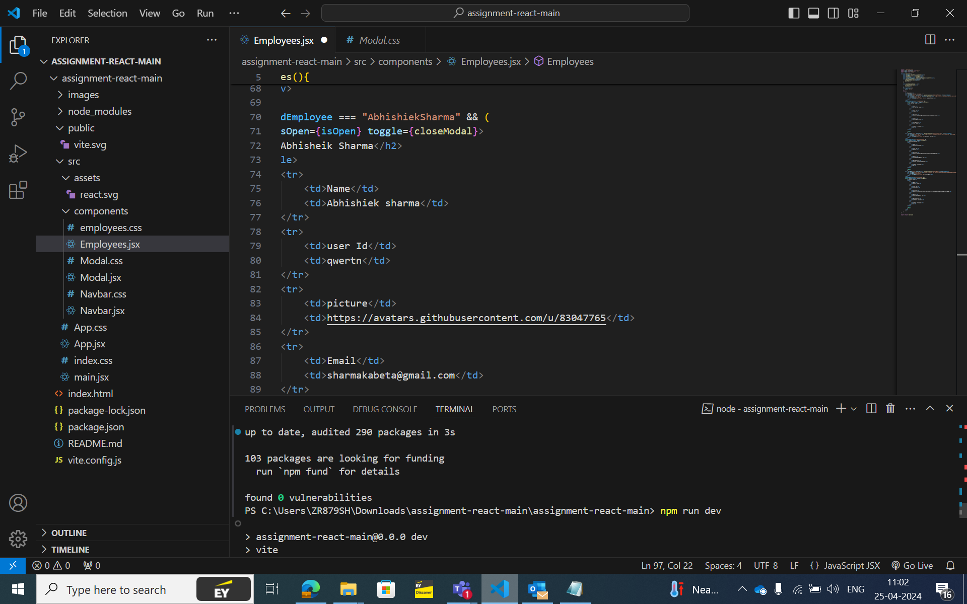
COMPONENTS
Under the src folder there are 5 components, they are;
1 – Employee
2 – Events
3 – Home
4 – Leaves
5 – Login
The Sync fusion Calendar is a powerful widget that allows developers to incorporate calendar functionality into their applications. Basically, it’s a type of API for making the scheduler.

Slide 6
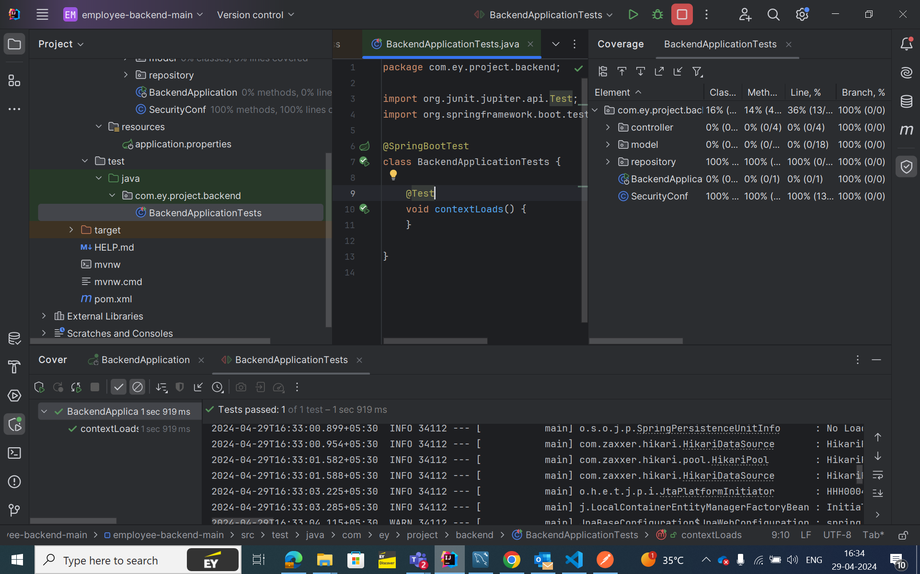
PACKAGES
Controller : In a Spring Boot application, the main purpose of a controller is to handle incoming HTTP requests and return an appropriate response. Controllers act as intermediaries between the client usually a web browser or a mobile app and the application.
Model package : It is used to create manager and employee table in the database.
Repository : In a Spring Boot backend application, the purpose of a repository package is closely tied to data access and persistence
SQL database is created in MySQL workbench
Application properties : It is used to link SQL server and spring boot.

Slide 7
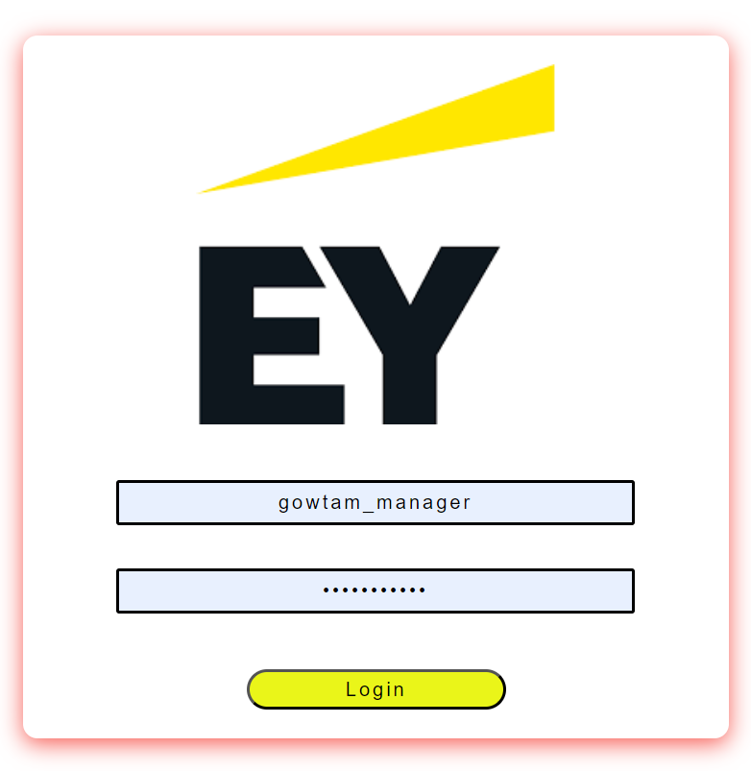
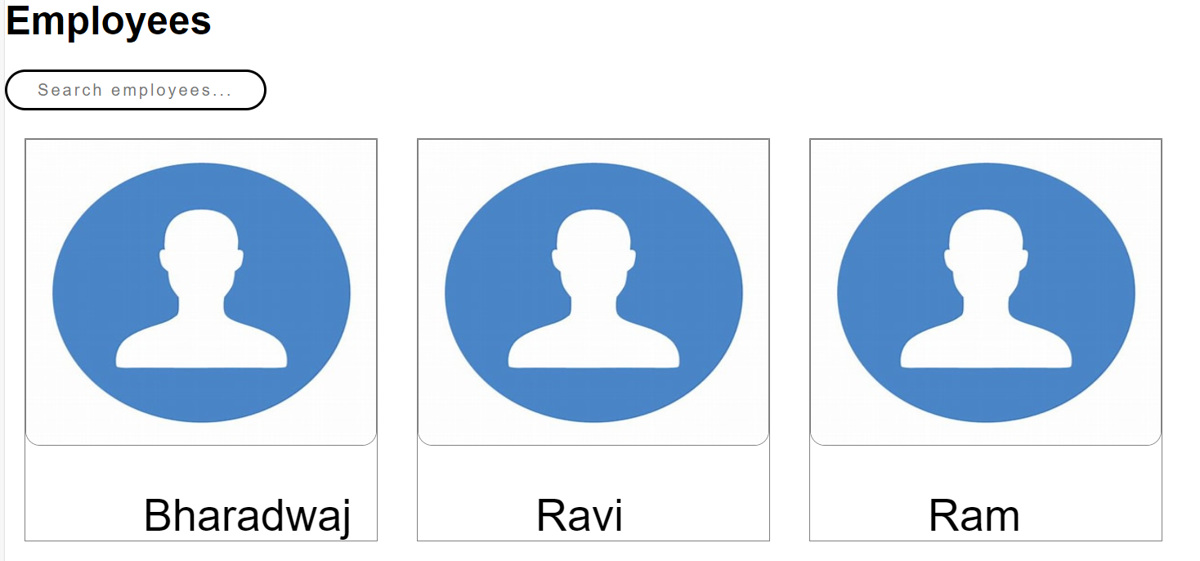
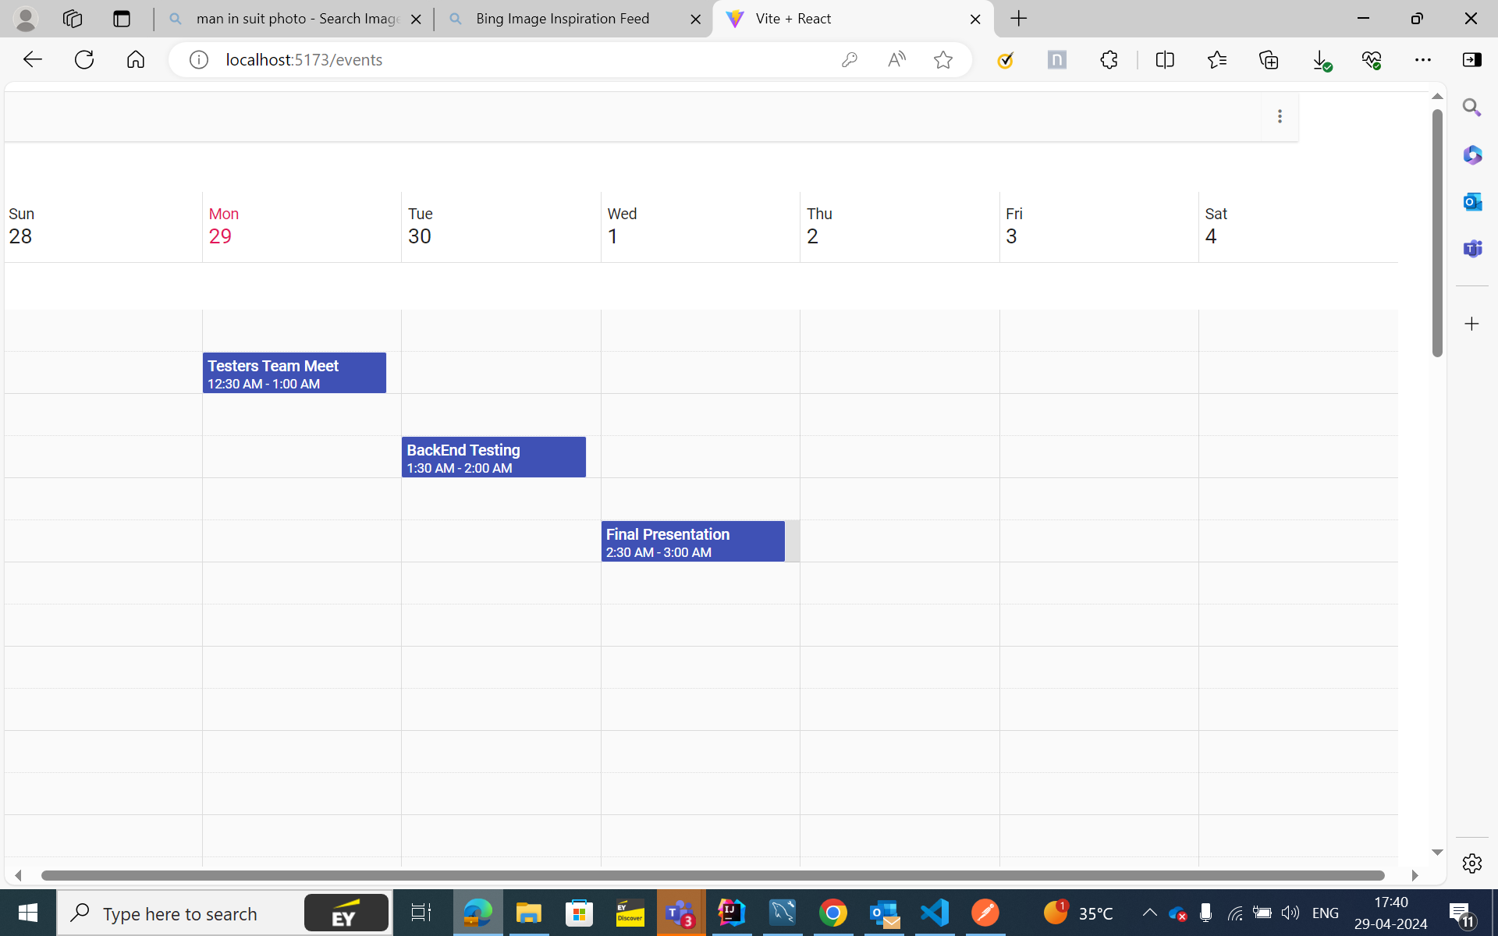
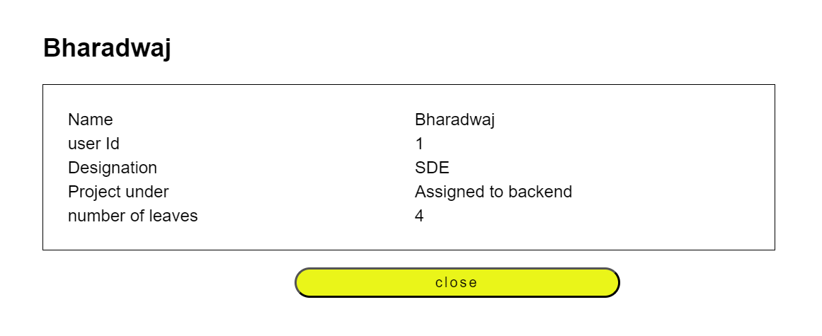
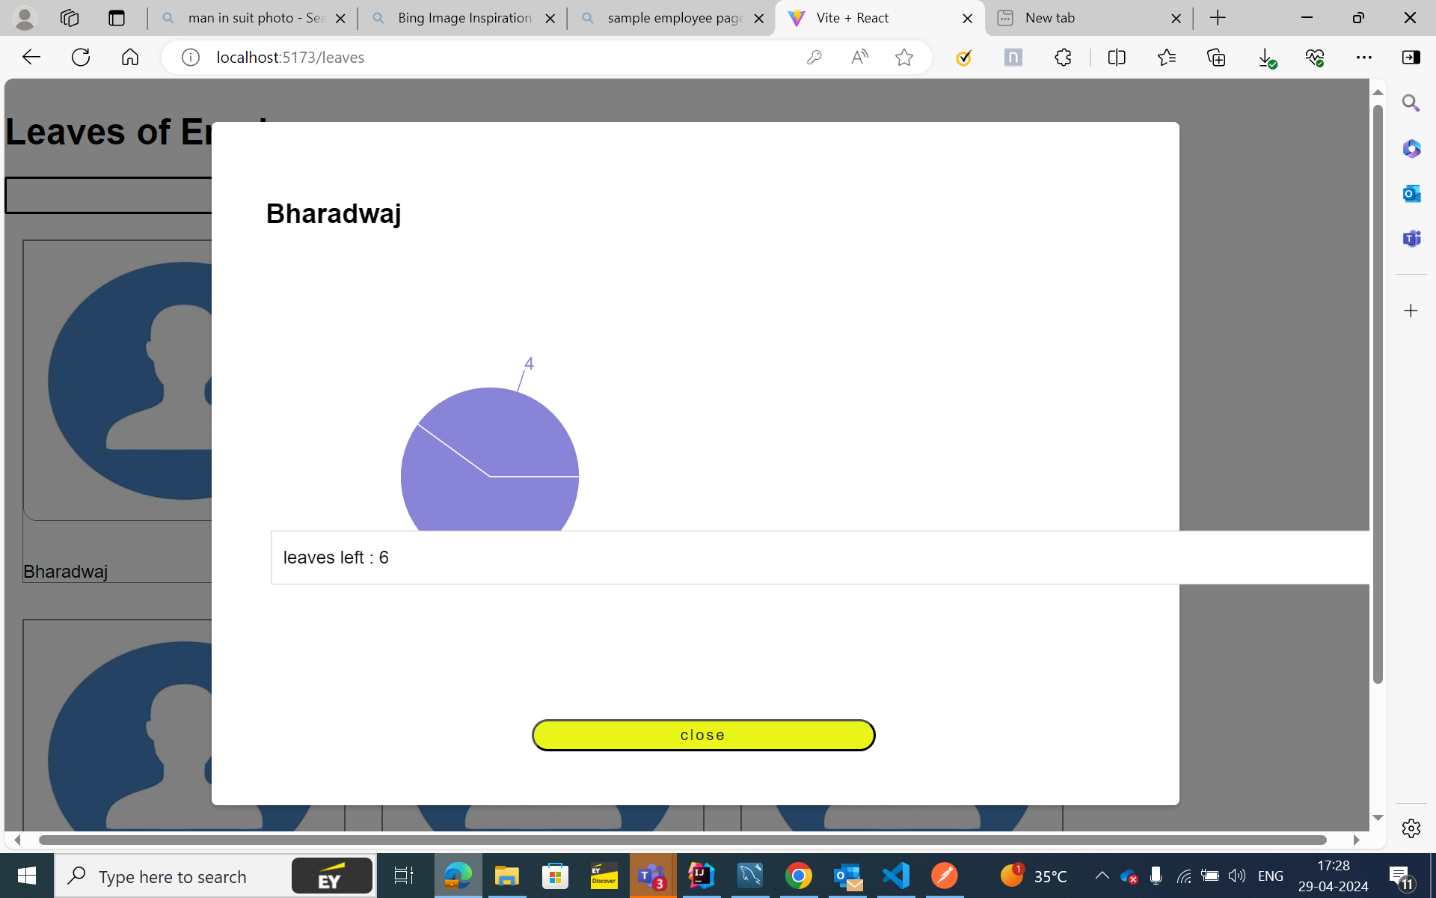
SCREENSHOTS

Slide 8
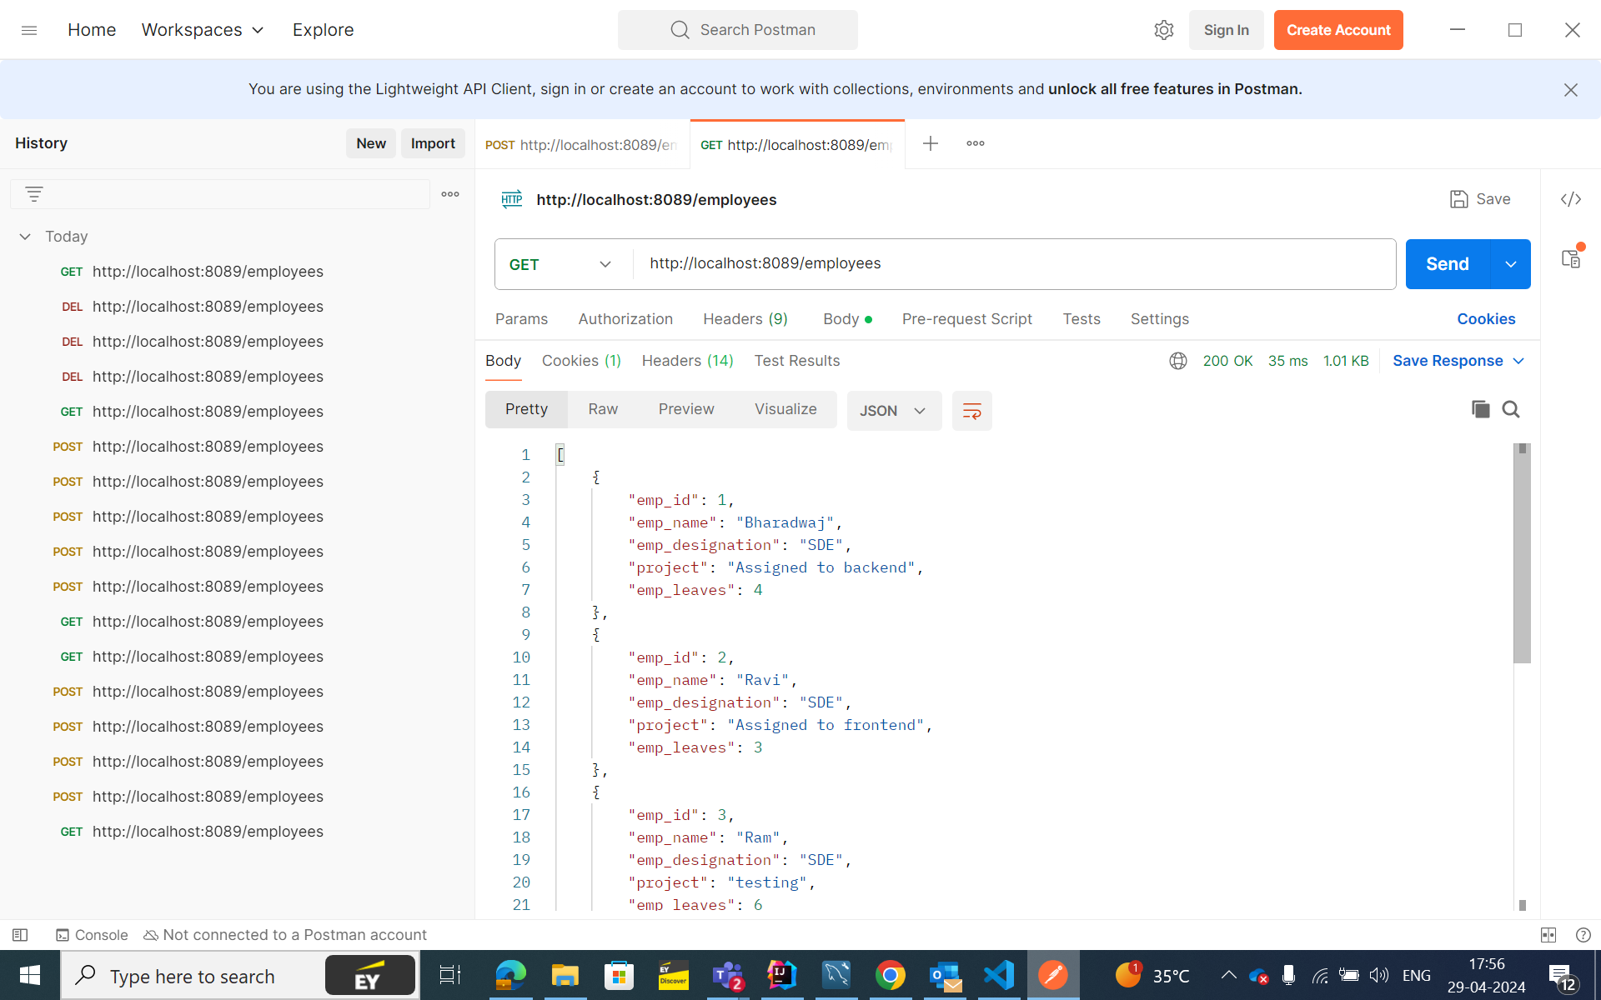
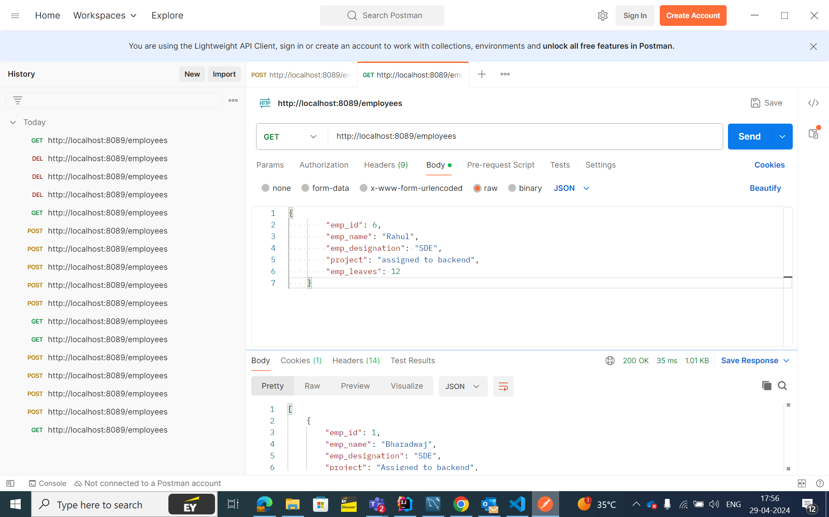
SCREENSHOTS

Slide 9
Future Scope
Integration with mobile apps for easy access to track the schedules on the go.
Adding features like live location and status of the team members .
Incorporating multiple users.
Adding live chat feature for the employees.

Slide 10

THANK YOU

